Slide 1

Urban Pulse – Smart city Mobility intelligence Platform
Analytics
Presented By:
Gundlakunta Madhuri Reddy

Slide 2
Project Overview
Urban Pulse is a Smart City Mobility Intelligence Platform that aims to analyze transportation-related data from multiple sources.
The project uses Power BI to build an interactive dashboard that helps understand city mobility patterns and supports data-driven decision making.
Main Objective
Collect data from different sources.
Clean and preprocess data
Analyze the data
Build an interactive dashboard
Generate meaningful insights for better decision-making

Slide 3
Learning Process
Data Preprocessing in Power Query
Import datasets
Remove duplicate records
Handle missing values
Change data types
Filter unnecessary rows
Data vs Information
Types of Data
Structured Data
Unstructured Data
Semi Structured Data
Data Sources Used
Geographic Data
Transportation Data
Weather Data
Ride-Hailing Data
Demographic Data

Slide 4
Learning Process
Data Visualization Techniques
p
Line Charts
Simple Line Chart
Multiple Line Chart
Column Charts
Clustered Column Chart
Stacked Column Chart
100% Stacked Column Chart
Bar Charts
Clustered Bar Chart
Stacked Bar Chart
100% Stacked Bar Chart
Pie chart
Donut chart

Slide 5
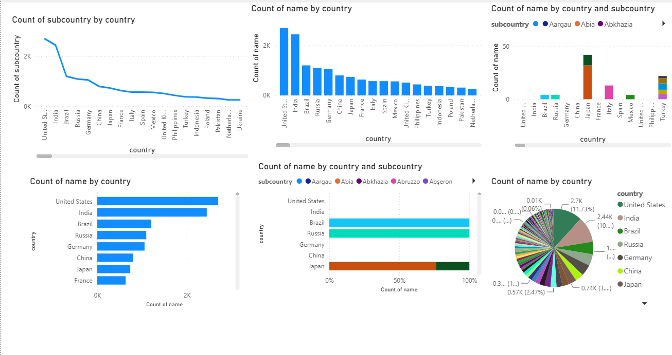
Geographic Data Visualization

Slide 6
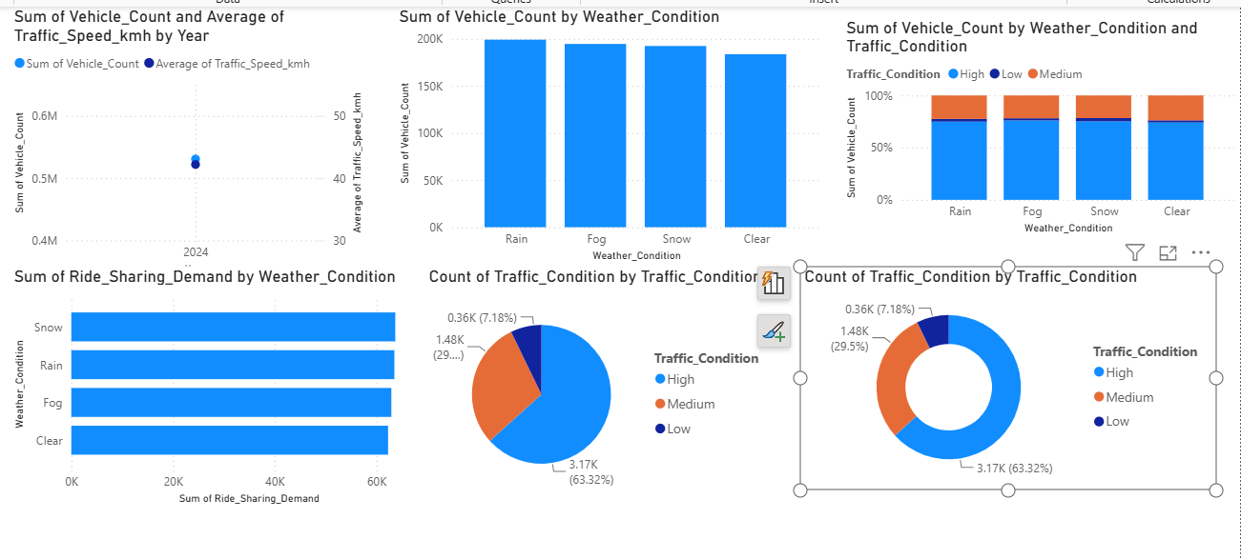
Transportation Data Visualization

Slide 7
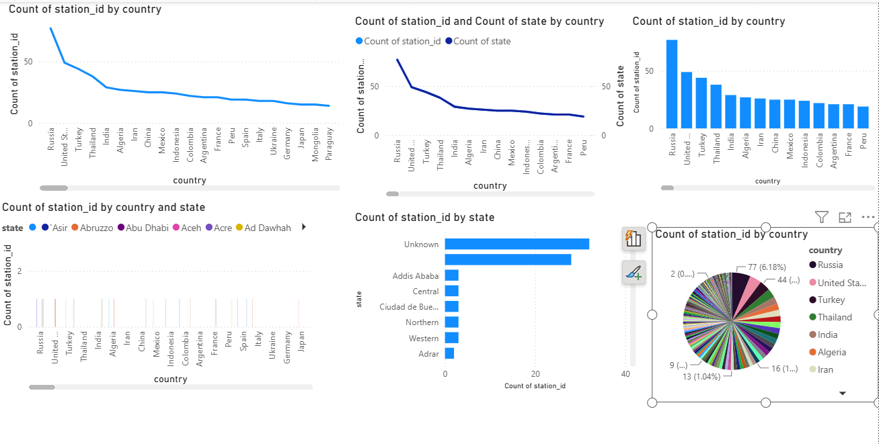
Weather Data Visualization

Slide 8
THANKYOU!

